Slide 1


Analyzing Engineers Writing for Non-engineers
Muhammad Nadeem, Morteza Biglari-Abhari
Department of Electrical, Computer, and Software Engineering
The University of Auckland
muhammad.nadeem@auckland.ac.nz

Slide 2
Introduction
Engineers spend ~60% of time in technical collaboration
Writings - proposals, design requirements, project progress reports, memos, and emails
Employers expectations - graduates to possess a high level of written communication skills
Poor communication reason behind catastrophic failures:
  Space Shuttle Challenger disaster
  Loss of the NASA Mars Climate Orbiter
Lack of written communication skills - negative effects on stress levels, deadlines, morale, health, and career growth

Slide 3
Engineering Curriculum
Communication skills - an important attribute for engineering graduates, ABET, Washington Accord,
Emphasizes technical and disciplinary knowledge
Writing is part of engineering job but not part of engineering
Lack of questions related to communication skills in the examination
Student impression - writing is not an important skill for engineers
Lecturer’s belief - it is the responsibility of the students to develop their communication skills
Insufficient measures by faculty – students fall short of expected communication skills

Slide 4
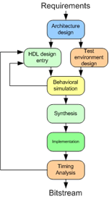
Writing Activity
This activity was mainly a practice of pitching an idea for students by answering following simple questions:
  What is it (idea)?
  What might the product/service do?
  What problem might it solve?
  Who will use it?
  What is valuable to the user?

Slide 5
Research
This research explores the impact of in-class writing activities in engineering with a view to improve written communication skills and promote critical thinking through real-world problem-based learning
The finding of this study will encourage other practitioners to include such exercises in their course design to improve written communication skills and develop other graduate attributes towards employability

Slide 6
Writing Exercises
Think of a real-world digital system which could be used to solve an existing problem in the community
Give an accurate and thorough description of it so that a designer is able to design a system based on the description provided by you
Give a description of how you would implement the system proposed using Field Programmable Gate Array (FPGA)
Writing exercises were peer reviewed. Students were required to in-corporate the feedback provided by peers into writing and re-submit improved version
Notes:
Muhammad Nadeem

Slide 7
Methodology
Third-year of computer systems engineering course, Digital System Design I
Class size ~ 65 students (75% male and 25% female)
  One third participants had English as an additional language
  23% attended all lectures and 12 % attended less than 50% lectures
Exercises peer reviewed anonymously, marked by lecturer
A cross-sectional questionnaire - six closed questions (Likert type scale) and 3 open-ended questions
Paper-based survey conducted by TA
Text responses analysed in NVivo v 11 software (QSR) using a general inductive approach
Limitation: Pilot study, single course, small sample size

Slide 8
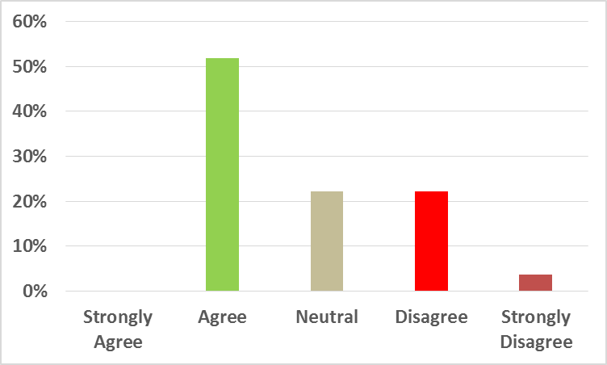
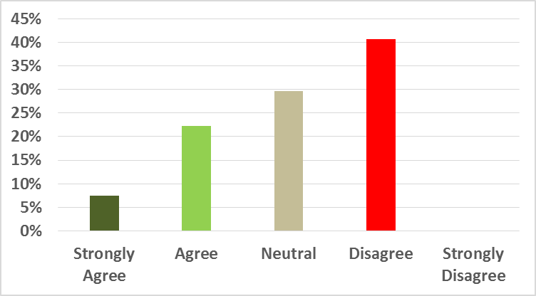
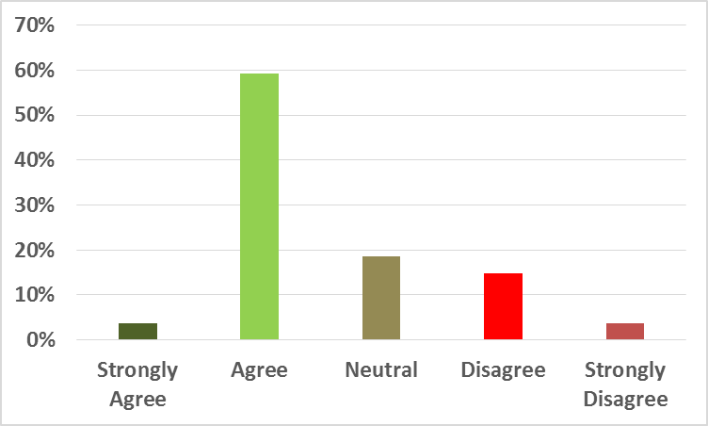
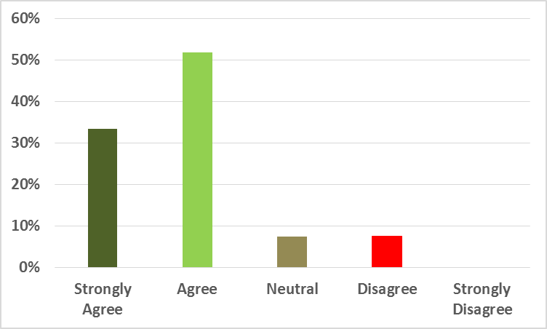
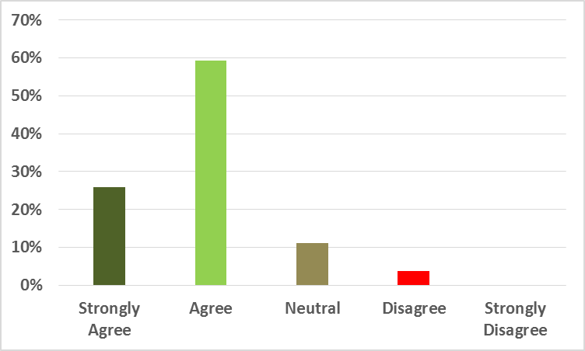
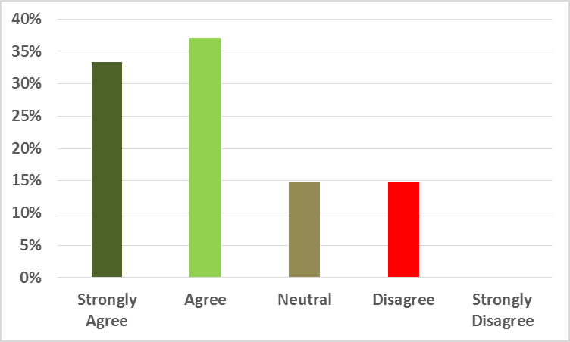
Results
(a) The writing exercises engaged me in the class
(b) The writing exercises motivated me to attend the lectures
(c) The writing exercises help me in achieving the course learning outcomes
(d) The writing exercises were intellectually stimulating and engaged me in critical thinking
(e) Evaluating the work of peers was a useful exercise
(f) The peer feedback helped me in improving the quality of writing

Slide 9
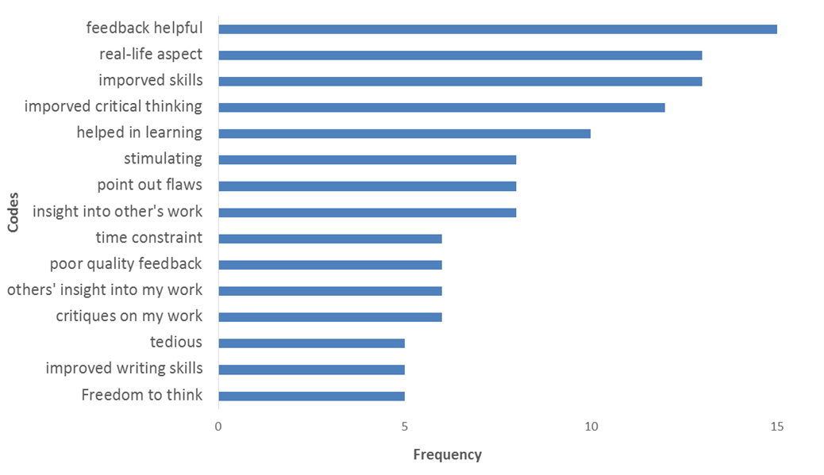
Findings
Writing activities can be a vehicle for teaching graduate competencies in engineering, such as communication skills
Transfer to other engineering contexts or across a program - a larger study spanning different courses and student populations to provide more general guidelines on how to embed communication skills activities into an engineering context

Slide 10
Summary
Our findings show that various writing exercises can be incorporated into the engineering courses as a strategy to enhance the communication skills of the students as well as their learning experience

Slide 11



